Slide 1

Gold Rush Antiques
Database
By: Kyle Johns, Chase Hunter, Isaiah Nazaire, and Jessica Kasongo

Slide 2
Intro
After the rapid growth of Gold Rush Antiques, a new system is needed to be able to manage multiple shop locations all while trying to increase their sales. Gold Rush Antiques is in need of a sales management system to manage:
Sales Transactions
Booths
Booth Locations
Product Inventory
The Gold Rush Antiques owner knows the efficiency a database system could give the company. The owner is aware that a centralized system that stretches across all locations will massively increase the company’s effectiveness. With this in mind, the owner of Gold Rush Antiques wants to implement a database to provide support for:
Employees
Customers
Dealers
Our Database will be the answer to their problem with our Forms, queries, and entity relationship diagram.

Slide 3
Problem
The problem is that management currently is not able to track all these variables and items in the stores that they currently have. They need a Database to be able to track all of these items.
Gold Rush Antiques have experienced heavy growth since their opening of three new locations in the past few years. The opening of these new stores created a need to fix pre-existing problems that include:
Employee Hours Logging
Label Creation for Sales
Hand-Written Price Tags
Simple Cash Register Transactions
Outdated Spreadsheet Practices
Not only does management need this Database for the current stores, but they also could use our Database solution for any other expansions beyond these three locations.

Slide 4
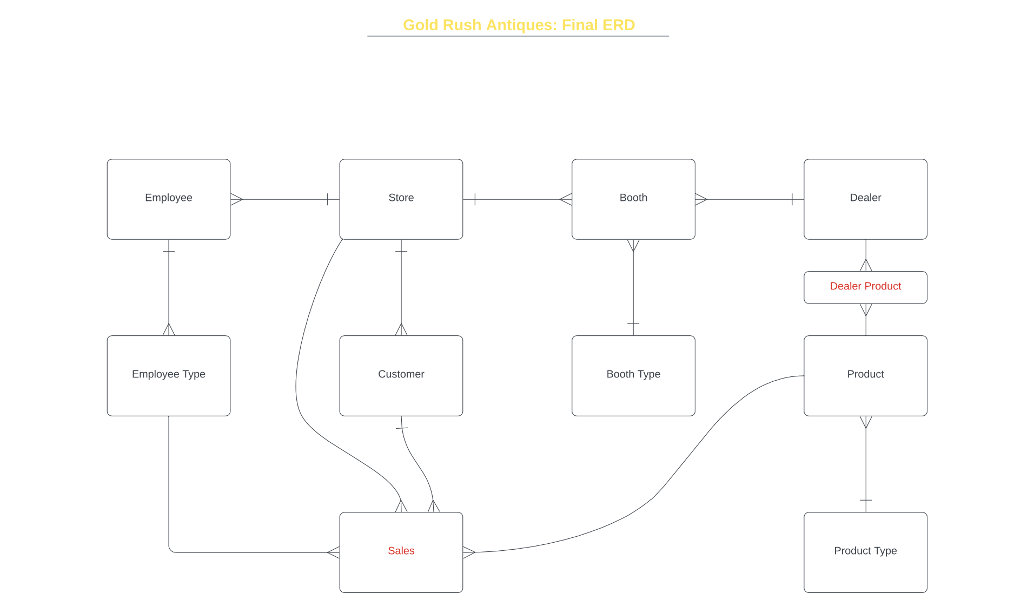
Entity Relationship diagram

Slide 5
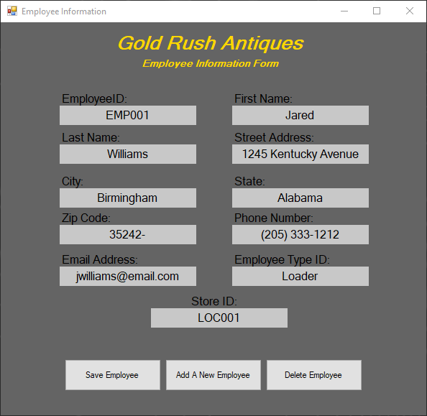
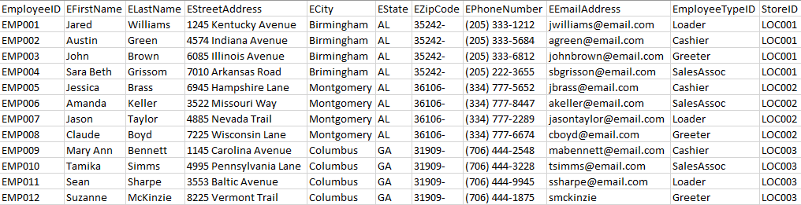
Employee Input Form
The Employee Input form helps management keep track of their employees at each location. On the Employee Input Form, dealers are able to edit employee information in the database through the Employee Information Form. The form also creates the ability to save the employees data, add a new employee, or delete an existing employee.
Sample Data From Select Employee Statement:

Slide 6
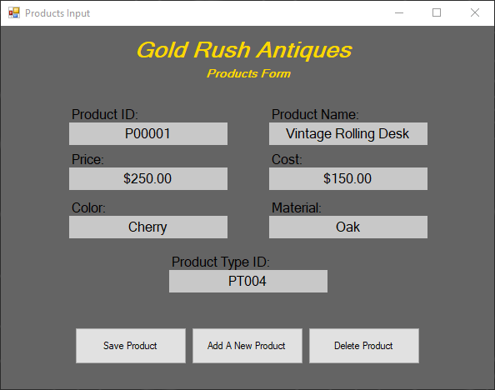
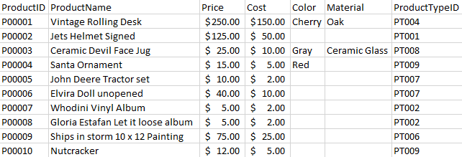
Products Input Form
A dealer can fill their booth with any product they desire, but 60% of the booths products must be considered antique or vintage, and the other 40% of the booths products can be a mix of different product types.
The Products input form helps a dealer determine what products they currently have in their inventory, and helps them maintain their 60/40 ratio of products on hand.
Sample Data From Select Product Statement:

Slide 7
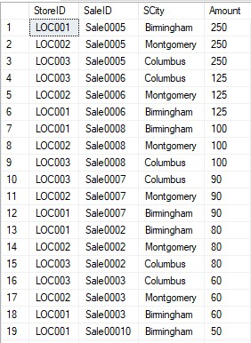

Stores of the Best Sales Query
Here we can run a query to see what stores are generating the highest sales. If management wanted to they could do some analysis or research to see what is going on in the stores and could figure out what products are selling
This could be really helpful if management to see what their locations are doing right and what others are doing wrong, whether that be vendors, products, locations, marketing or any mix.

Slide 8
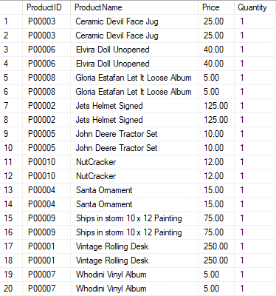

Products listed Query
Here we can see what products are associated with what Product ID. Here we could see what products are being sold in what orders, how much they cost, and how many are on hand for each antique store.
Management could do more with this query like figuring what products are selling more than others and how many to forecast and have on hand at each Antique store

Slide 9
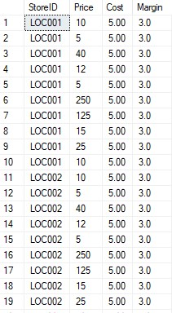
Stores and Margin Query
From the following Query we are able to see stores are selling products for and exactly how margin they are making on each product as well as their cost. Management could then track down what products they could want to keep.
Depending on what location sells more of low margin or higher margin depending on the income of the margin.

Slide 10
Trigger
Create Table NewCustomer(
CustomerID varchar(50),
Status varchar(30),
CustomerFName Varchar(50),
CustomerLName varchar(50));
CREATE TRIGGER dbo.Customers_NEW
ON dbo.Customer
AFTER INSERT
AS
BEGIN
SET NOCOUNT ON;
DECLARE @CustomerID varchar(50)
Declare @CustomerFName Varchar(50)
Declare @CustomerLName Varchar(50)
Select @CustomerID = CustomerList.CustomerID FROM inserted CustomerList
Select @CustomerFName = CustomerList.CustomerFName FROM inserted CustomerList
Select @CustomerLName = CustomerList.CustomerLName FROM inserted CustomerList
Insert INTO NewCustomer
Values(@CustomerID, 'Inserted',@CustomerFName,@CustomerLName)
END
GO
This trigger automatically keeps track of new customers added to the database by adding them to a special table called “New Customers” and shows their CID, First, and last name

Slide 11
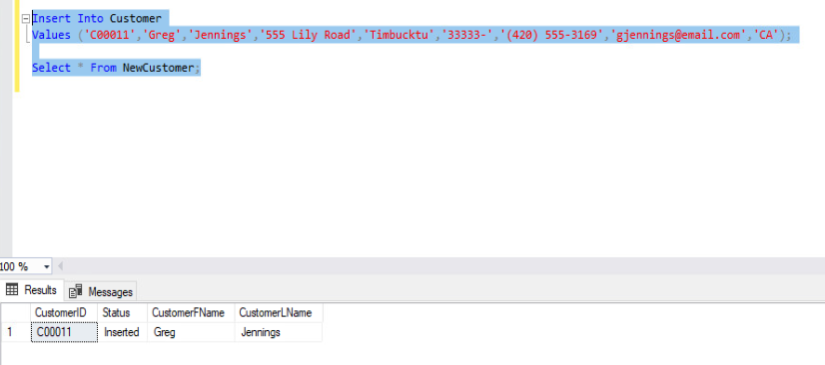
Trigger - Example

Slide 12
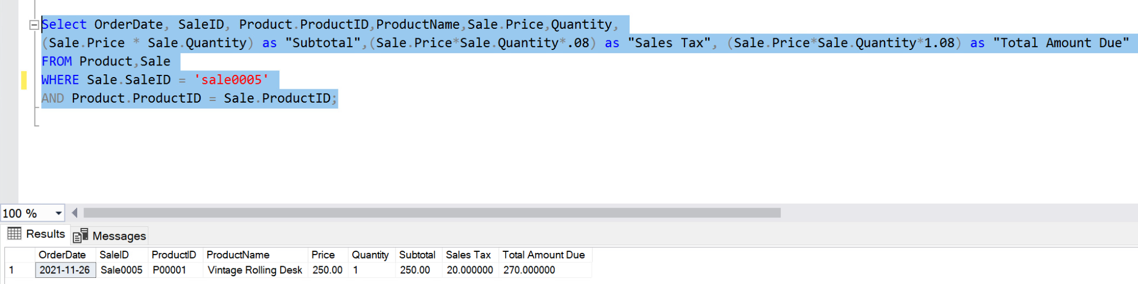
Report

Slide 13
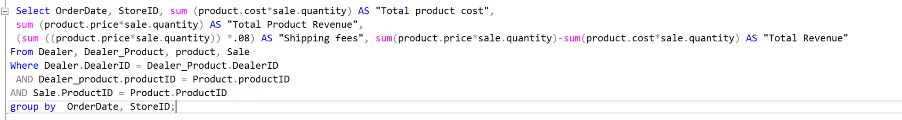
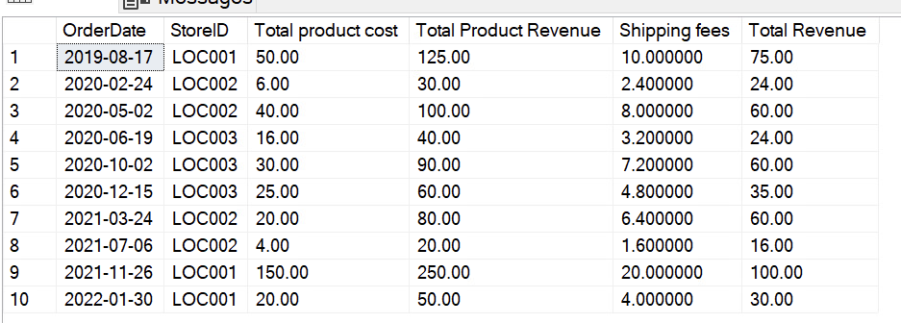
Report

Slide 14
Conclusion
There is no doubt that Gold Rush Antiques is in need of a decent Database management system, and ours is designed for their management needs and what could come of the future. If Gold Rush Antiques uses our system, there will be no doubt a well for the future in their growth. With our new sales management system managing sales transactions, booths, booth locations, and product inventory, as well as our database system that supports their employees, dealers, and customers. Gold Rush Antiques can anticipate a large increase in productivity and efficiency which will result in an increase in company performance in the long run.

